Slide 1
General tree vs. binary tree
P
Q
R
S
T
O
V
W
X
Y
Z
A
I
U
B

Slide 2
General tree
P
O
Q
R
V
S
T
Y
W
Z
A
I
U
B
X
General tree can’t be empty.
No limit on the degree of node in a general tree.
Root have in-degree 0 and maximum out-degree n
Each node have in-degree one and maximum out-degree n.

Slide 3
Binary tree
P
Q
R
A
I
U
B
A Binary tree can be empty.
each node has at most two nodes left and right
root have in-degree 0 and maximum out-degree 2.
each node have in-degree one and maximum out-degree 2.

Slide 4
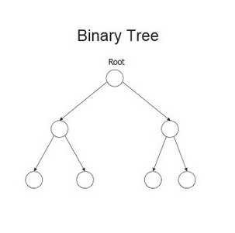
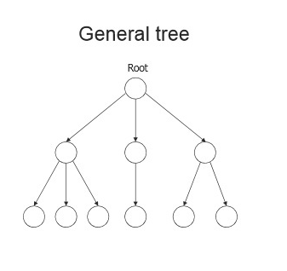
Tree vs. binary tree

